Slide 1
Machine Learning Workflow
vers. 20211220

Slide 2
Agenda
Machine Learning Workflow
3
ML Workflow
16
ML Workflow with code demo
30
ML Workflow In-depth Example

Slide 3
ML Workflow

Slide 4
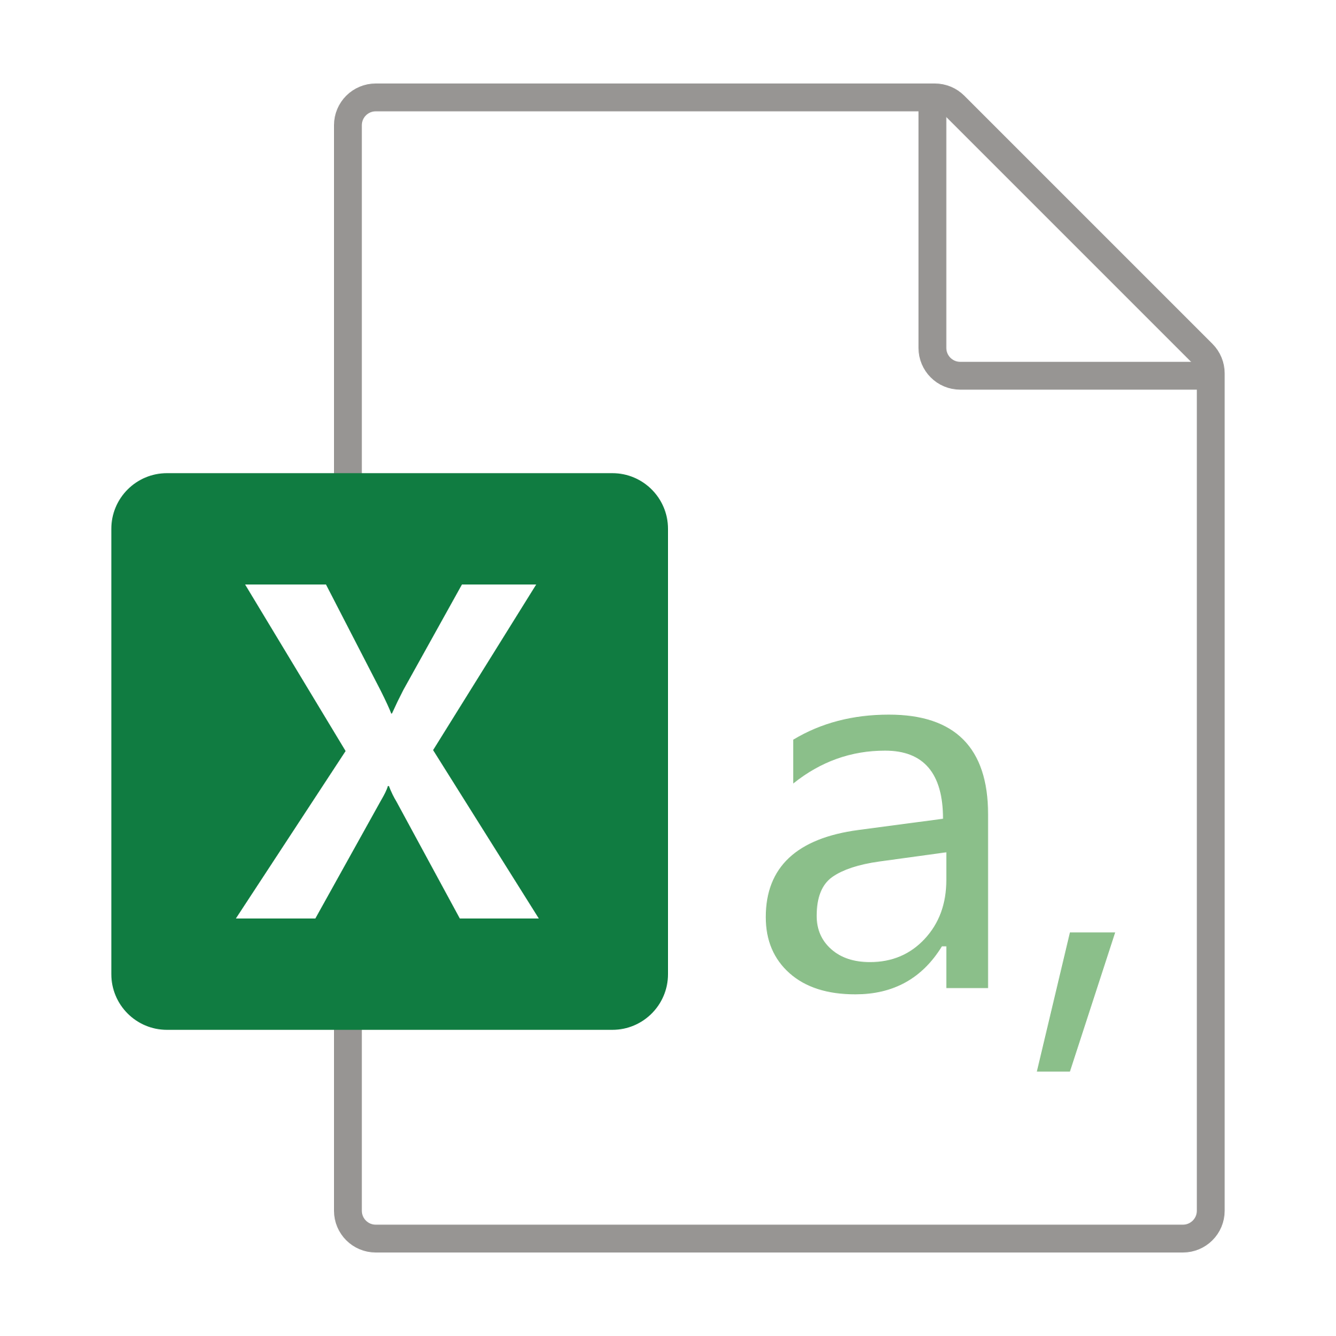
Machine Learning Workflow
Understanding the ML Workflow

Slide 5
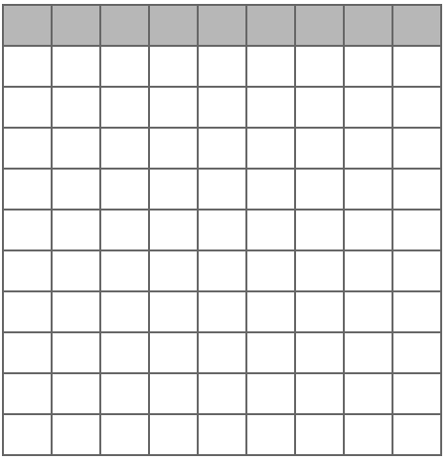
Loading Data (INPUT)
Understanding the ML Workflow
1

Slide 6
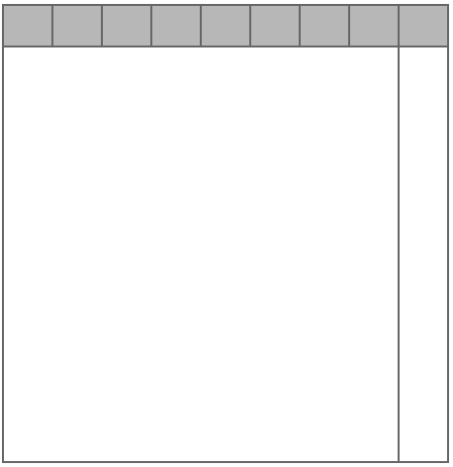
2. Label Data
Understanding the ML Workflow
2
(Label)
X
(Feature)
Y
1

Slide 7
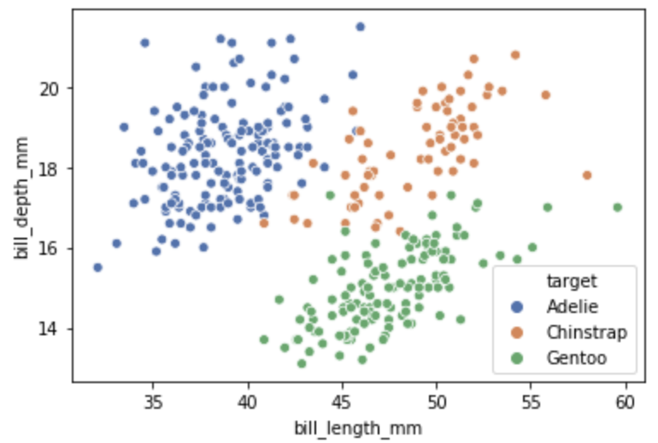
3. Explore Data
Understanding the ML Workflow
2
3
(Label)
X
(Feature)
Y
Data Exploration
1

Slide 8
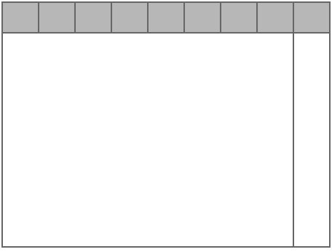
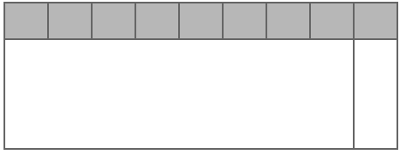
4. Split Data into Train/Test
Understanding the ML Workflow
2
3
(Label)
X
(Feature)
Y
Data Exploration
1
4
Train
Test

Slide 9
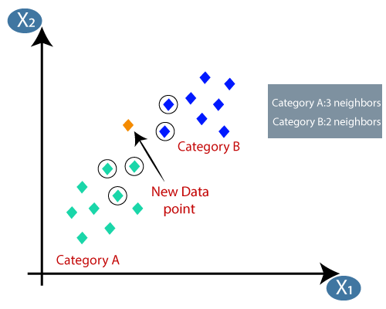
5. Train Models
Understanding the ML Workflow
2
3
(Label)
X
(Feature)
Y
Data Exploration
1
5
4
KNN
Model
Train
Model
Training
Test

Slide 10
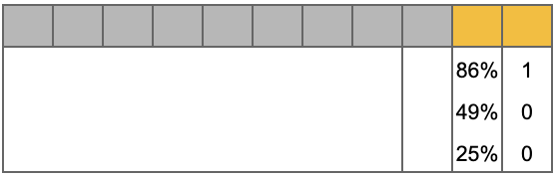
6. Make Prediction on Test Data
Understanding the ML Workflow
2
3
(Label)
X
(Feature)
Y
Data Exploration
1
5
4
KNN
Model
Train
Model
Training
6
Test
Predict

Slide 11
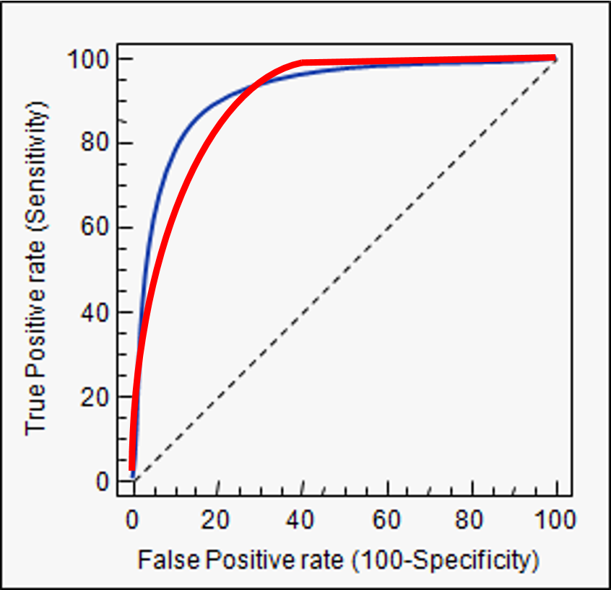
7. Evaluate the Model Prediction
Understanding the ML Workflow
2
3
(Label)
X
(Feature)
Y
Data Exploration
1
5
4
KNN
Model
Train
Model
Training
7
6
Test
Predict
85%

Slide 12
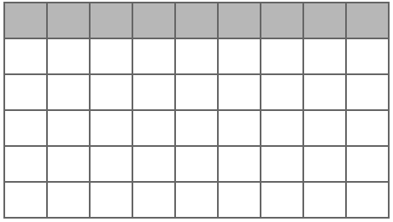
8. Load New/Unseen Data
Understanding the ML Workflow
2
3
(Label)
X
(Feature)
Y
Data Exploration
1
5
4
KNN
Model
Train
Model
Training
7
6
Test
Predict
8
85%
New Data

Slide 13
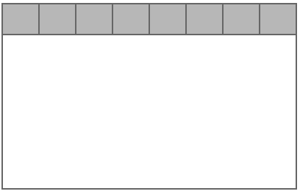
9. Prepare the New Data
Understanding the ML Workflow
2
3
(Label)
X
(Feature)
Y
Data Exploration
1
5
4
KNN
Model
Train
Model
Training
7
6
Test
Predict
8
85%
9
New Data
Prepared

Slide 14
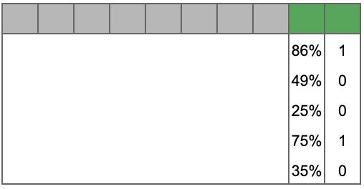
10. Generate Prediction on New Data (OUTPUT)
Understanding the ML Workflow
2
3
(Label)
X
(Feature)
Y
Data Exploration
1
5
4
KNN
Model
Train
Model
Training
7
6
Test
Predict
8
85%
10
9
Predict
Prediction
New Data
Prepared

Slide 15
11. Use the Model Prediction
Understanding the ML Workflow
2
3
(Label)
X
(Feature)
Y
Data Exploration
1
5
4
KNN
Model
Train
Model
Training
7
6
Test
Predict
8
85%
10
9
Predict
Prediction
New Data
Prepared
Business
Use Cases
11

Slide 16
ML Workflow
with code demo

Slide 17
Machine Learning Process - Beginner
Let’s go through the workflow again,
with code demo
Understanding the ML Workflow

Slide 18
1. Load Data
# step 1 - load data
iris = pd.read_csv('iris/iris.csv')

Slide 19
2. Label Data
2
(Label)
X
(Feature)
Y
1
# step 2 - label data
X = iris.loc[:, iris.columns.drop('Species')]
y = pd.Series(iris.Species).map({'setosa': 0, 'versicolor':0, 'virginica':1})
.to_frame()
.rename(columns={0:'target'})

Slide 20
3. Explore Data
2
3
(Label)
X
(Feature)
Y
Data Exploration
1
# step 3 - explore data
X.plot.scatter(x="Sepal.Length", y="Sepal.Width", figsize=(6,4))

Slide 21
4. Split Data
2
3
(Label)
X
(Feature)
Y
Data Exploration
1
4
Train
Test
# step 4 - split data into train vs test
from sklearn.model_selection import train_test_split
X_train, X_test, y_train, y_test = train_test_split(X, y,
test_size=0.3,
shuffle=True,
random_state=2018)

Slide 22
5. Model Training
2
3
(Label)
X
(Feature)
Y
Data Exploration
1
5
4
KNN
Model
Train
Model
Training
Test
# step 5 - model training
from sklearn.neighbors import KNeighborsClassifier
knn = KNeighborsClassifier(n_neighbors=10)
knn.fit(X_train, y_train)

Slide 23
6. Prediction on Test
2
3
(Label)
X
(Feature)
Y
Data Exploration
1
5
4
KNN
Model
Train
Model
Training
6
Test
Predict
# step 6 - generate prediction
predictions = knn.predict(X_test)

Slide 24
7. Evaluation
2
3
(Label)
X
(Feature)
Y
Data Exploration
1
5
4
KNN
Model
Train
Model
Training
7
6
Test
Predict
85%
# step 7 - model evaluation
accuracy = sum(predictions == y_test.Species.values) / float(len(y_test))
print (accuracy)

Slide 25
8. Read New Data
2
3
(Label)
X
(Feature)
Y
Data Exploration
1
5
4
KNN
Model
Train
Model
Training
7
6
Test
Predict
8
85%
New Data
# step 8 - load new data
iris_new = pd.read_csv('iris_new.csv')

Slide 26
9. Prepare New Data
2
3
(Label)
X
(Feature)
Y
Data Exploration
1
5
4
KNN
Model
Train
Model
Training
7
6
Test
Predict
8
85%
9
New Data
Prepared
# step 9 - prepare new data
new_prepared = iris_new.loc[:, iris_new.columns.drop('Species')]

Slide 27
10. Generate Prediction
2
3
(Label)
X
(Feature)
Y
Data Exploration
1
5
4
KNN
Model
Train
Model
Training
7
6
Test
Predict
8
85%
10
9
Predict
Prediction
New Data
Prepared
# step 10 - make predictions on new data
new_prediction = knn.predict(new_prepared)
print(new_prediction)

Slide 28
11. Business Use Cases
2
3
(Label)
X
(Feature)
Y
Data Exploration
1
5
4
KNN
Model
Train
Model
Training
7
6
Test
Predict
8
85%
10
9
Predict
Prediction
New Data
Prepared
Business
Use Cases
11

Slide 29
Machine Learning
Understanding the ML Workflow
%matplotlib inline
import matplotlib.pylab as plt
import numpy as np
import pandas as pd
# step 1 - load data
iris = pd.read_csv('https://s3.amazonaws.com/weclouddata/datasets/random/iris/iris.csv')
# step 2 - label data
X = iris.loc[:, iris.columns.drop('Species')]
y = pd.Series(iris.Species).map({'setosa': 0, 'versicolor':0, 'virginica':1}).to_frame().rename(columns={0:'target'})
# step 3 - explore data
X.plot.scatter(x="Sepal.Length", y="Sepal.Width", figsize=(6,4))
# step 4 - split data into train vs test
from sklearn.model_selection import train_test_split
X_train, X_test, y_train, y_test = train_test_split(X, y, test_size=0.3, shuffle=True, random_state=2018)
# step 5 - model training
from sklearn.neighbors import KNeighborsClassifier
knn = KNeighborsClassifier(n_neighbors=10)
knn.fit(X_train, y_train)
# step 6 - generate prediction
predictions = knn.predict(X_test)
# step 7 - model evaluation
accuracy = sum(predictions == y_test.Species.values) / float(len(y_test))
print (accuracy)
# step 8 - load new data
iris_new = pd.read_csv('https://s3.amazonaws.com/weclouddata/datasets/random/iris/iris.csv')
# step 9 - prepare new data
new_prepared = iris_new.loc[:, iris_new.columns.drop('Species')]
# step 10 - make predictions on new data
new_prediction = knn.predict(new_prepared)
print(new_prediction)
https://pinetools.com/syntax-highlighter

Slide 30
ML Workflow
In-depth Example

Slide 31
Machine Learning
Too abstract?
Let’s look at an example
Understanding the ML Workflow

Slide 32

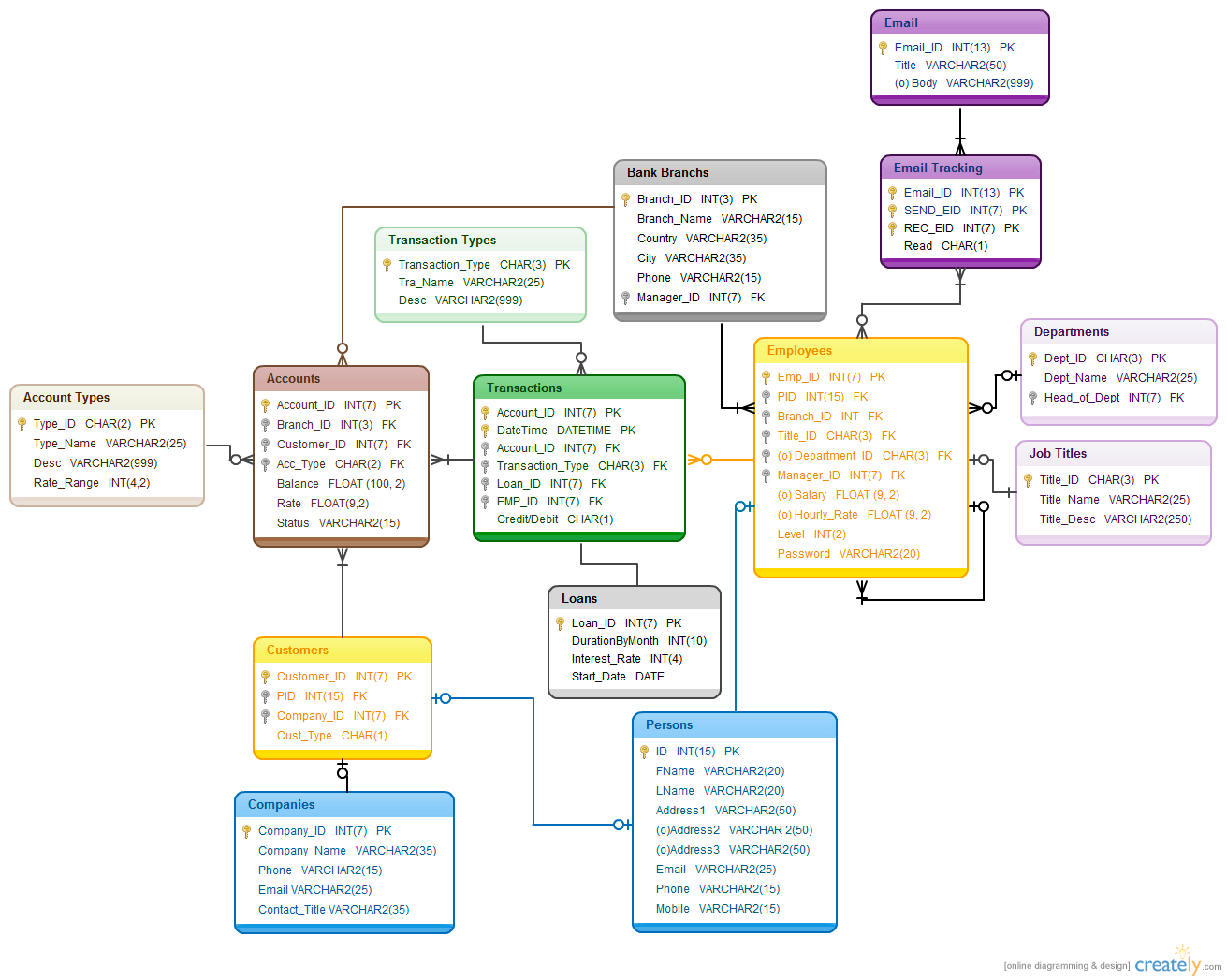

Data Collection
Data Collection
Data Preparation
Data Exploration
Understanding the ML Workflow
Feature Engineering
Modeling
Validation
Interpretation
Deployment
Plant
Harvest
Process
Grading
Data is typically collected via
Application/operations databases (CRM, HR, Marketing)
Automated data scraping
Manual data entry
Latte
Brew
Grind
Roast
Notes:
[speak to experience]

Slide 33
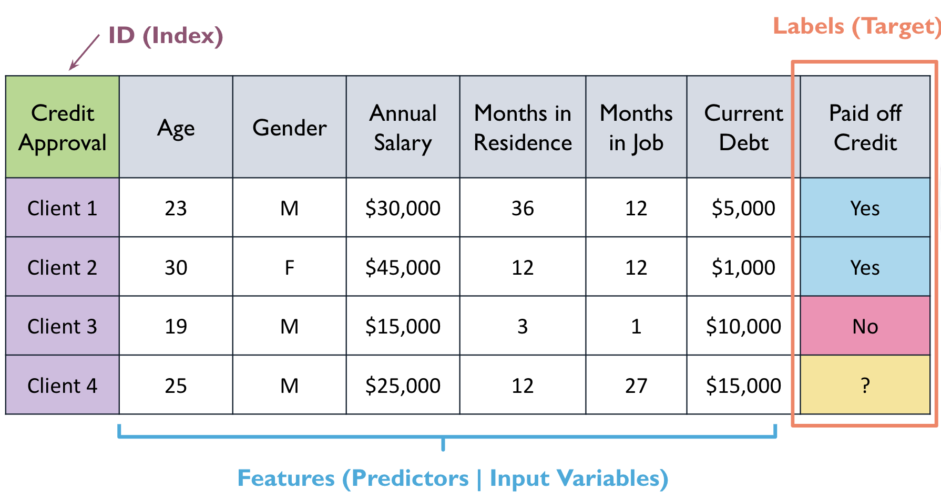
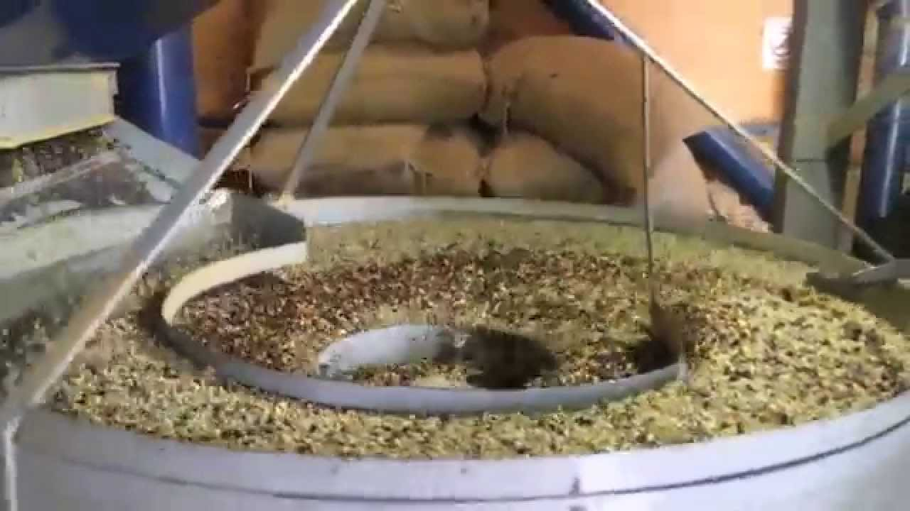
Data Preparation
Data Collection
Data Preparation
Data Exploration
Understanding the ML Workflow
Feature Engineering
Modeling
Validation
Interpretation
Deployment
Plant
Harvest
Process
Grading
Data gets cleaned and transformed into a
ML-friendly format
Common data prep tools include
  Excel, SQL, Python
  No-Code data prep tool such as Sagemaker
Latte
Brew
Grind
Roast
Notes:
[speak to experience]

Slide 34
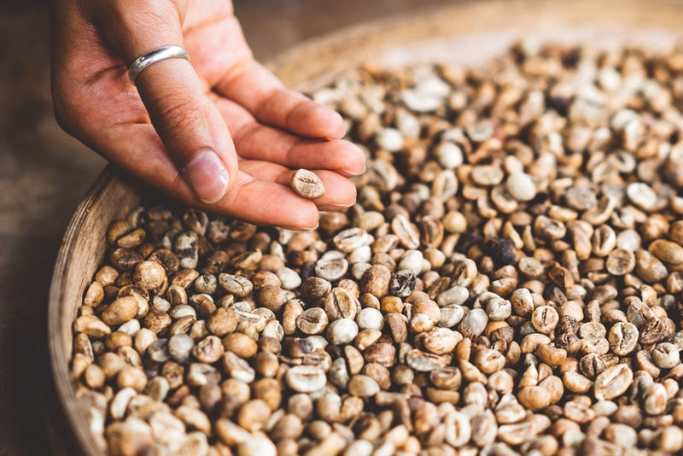
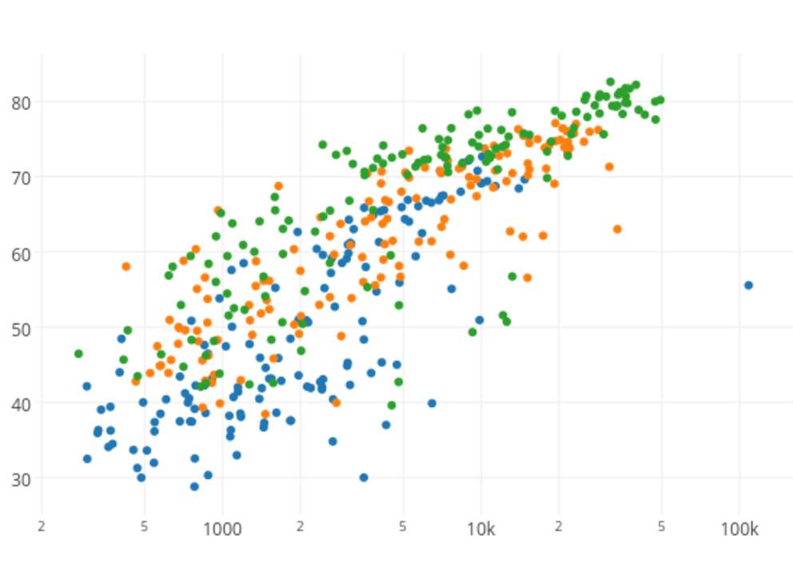
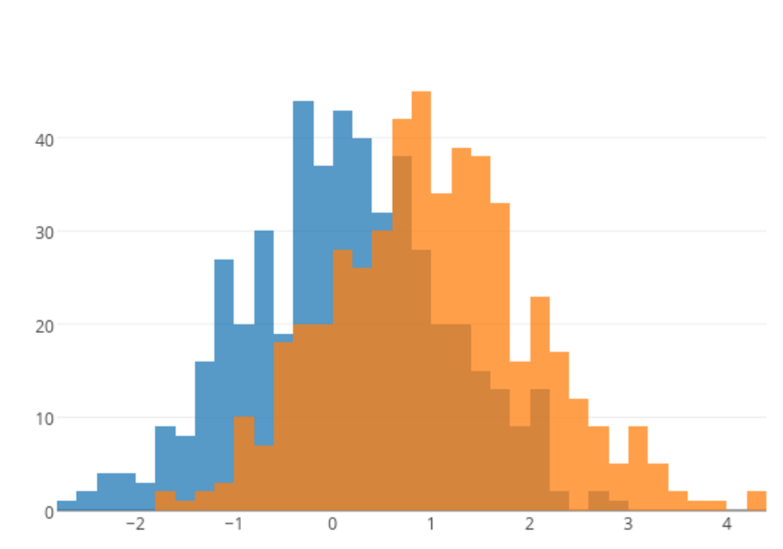
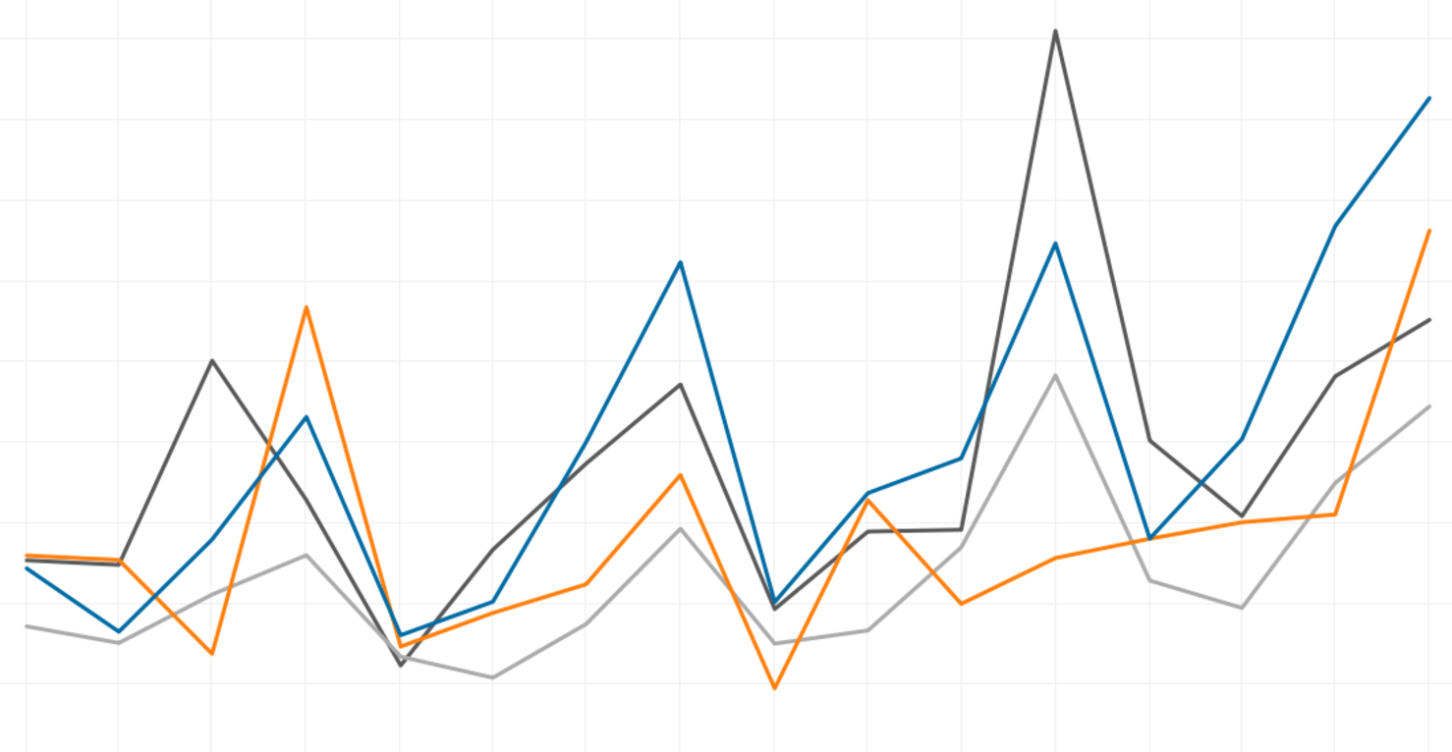
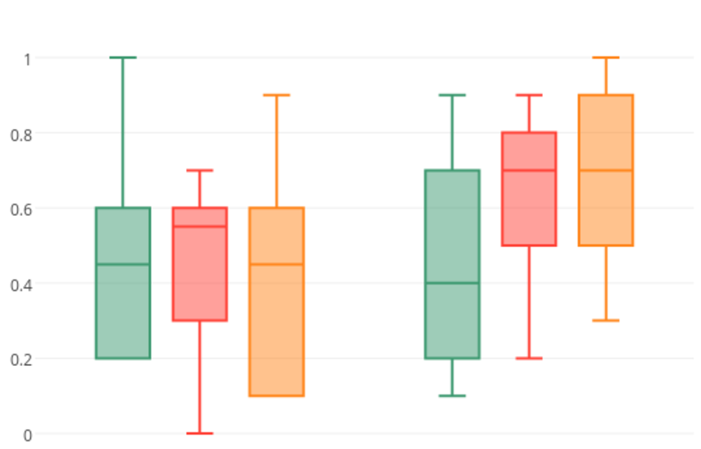
Data Exploration
Data Collection
Data Preparation
Data Exploration
Feature Engineering
Understanding the ML Workflow
Modeling
Validation
Interpretation
Deployment
Plant
Harvest
Process
Grading
Data visualization and exploration is a key step to understand about the data problems
Tools include: Excel, Tableau, PowerBI, SageMaker, Python
Latte
Brew
Grind
Roast
Notes:
[speak to experience]
[read slide… and then]
Visualization is key for feature extraction. It helps you to select or derive relevant features from the raw data. This step involves identifying variables that contribute meaningfully to the problem being solved. Visual tools can be best for this, on top of understanding the contextual relevance of the variables in the particular business context of course.

Slide 35
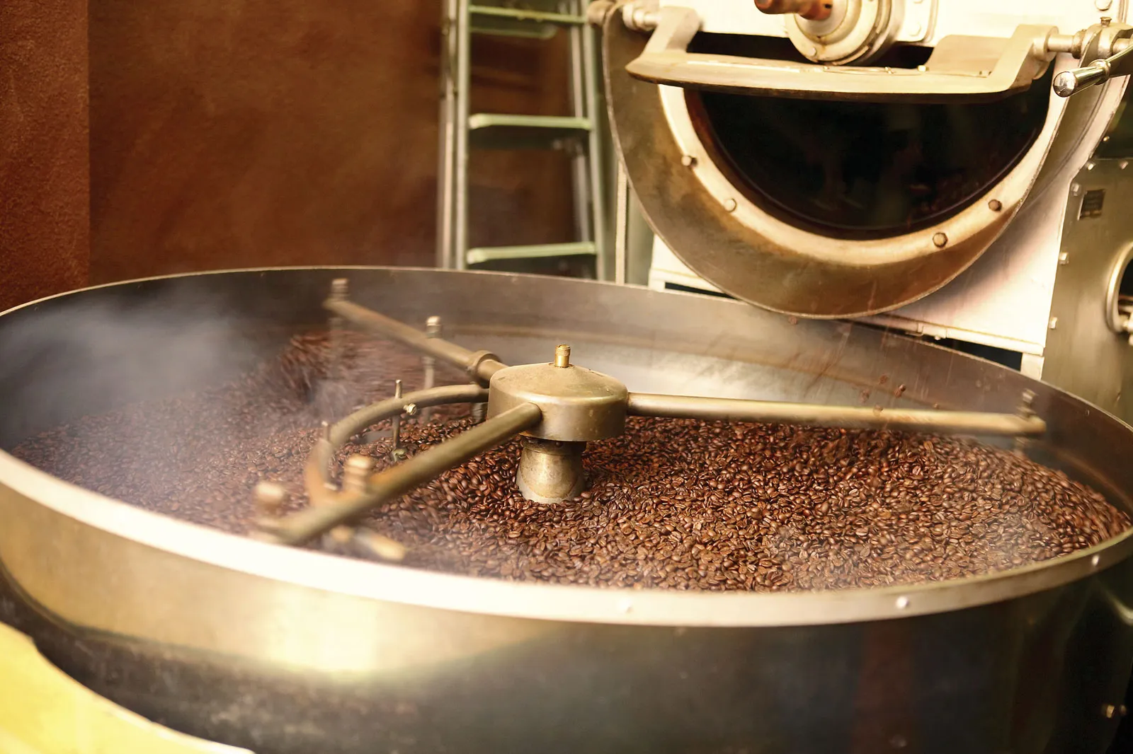
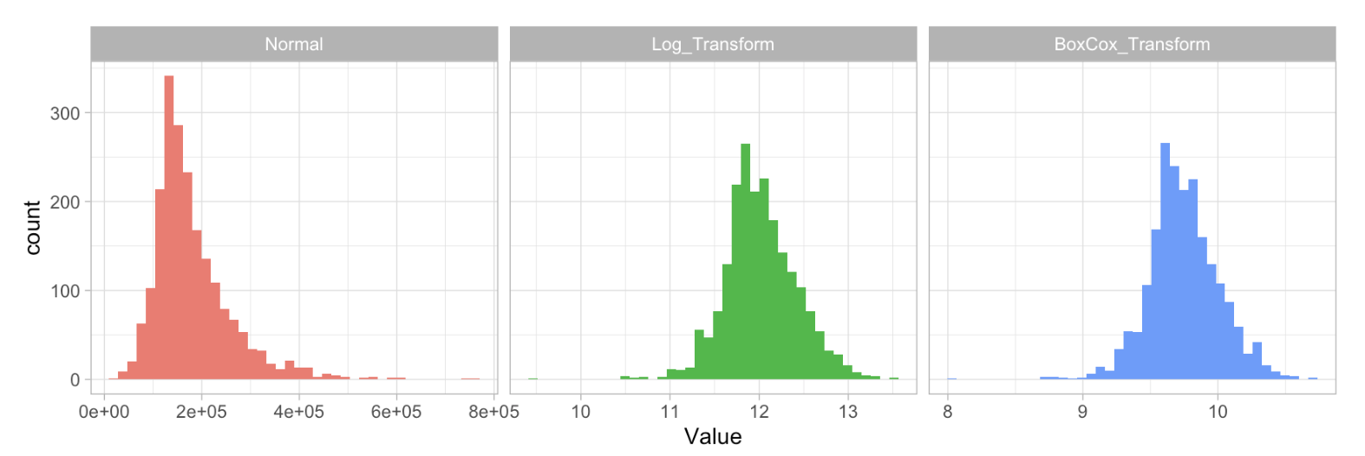
Feature Engineering
Data Collection
Data Preparation
Data Exploration
Understanding the ML Workflow
Feature Engineering
Modeling
Validation
Interpretation
Deployment
Plant
Harvest
Process
Grading
Data gets turned into features which are then engineered to empower high-performance models
Feature preparation tools include:
  SQL, Python, R, Sagemaker, etc.
Latte
Brew
Grind
Roast
https://bradleyboehmke.github.io/HOML/engineering.html
Notes:
[speak to experience]
Transform and enhance features to provide more information to the model. This may include creating interaction terms, scaling, or encoding categorical variables.

Slide 36
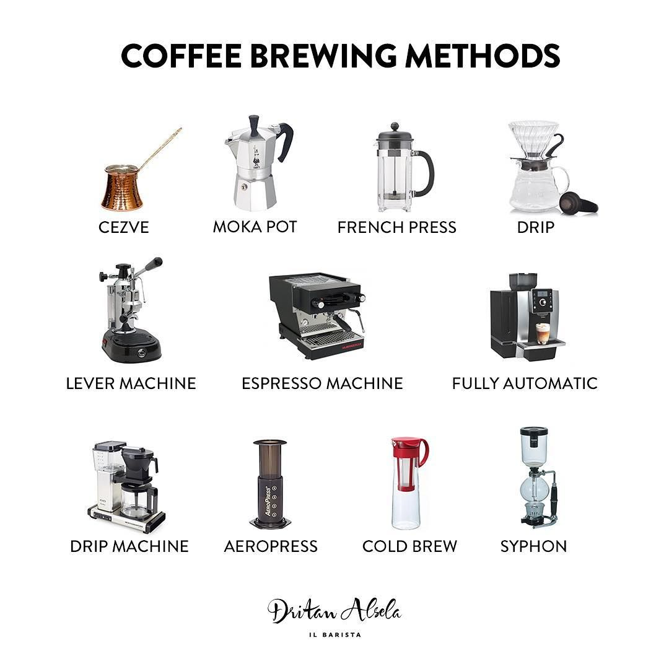
Modeling
Data Collection
Data Preparation
Data Exploration
Understanding the ML Workflow
Feature Engineering
Modeling
Validation
Interpretation
Deployment
Plant
Harvest
Process
Grading
During the modeling stage, different ML algorithms are tried and the best one is selected
ML tools:
  Python, PyTorch, Tensorflow, SageMaker, etc.
Latte
Brew
Grind
Roast

Slide 37
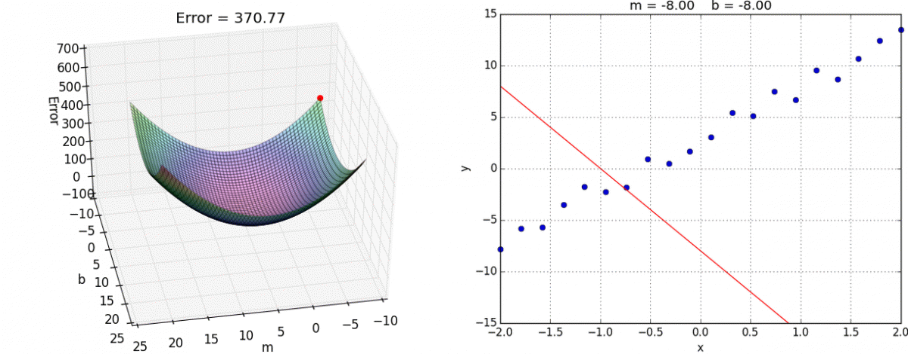
Modeling: Linear Regression
Data Collection
Data Preparation
Data Exploration
Understanding the ML Workflow
Feature Engineering
Modeling
Validation
Interpretation
Deployment

Slide 38
Demo: Linear Regression
A Visual Introduction to Linear Regression

Slide 39
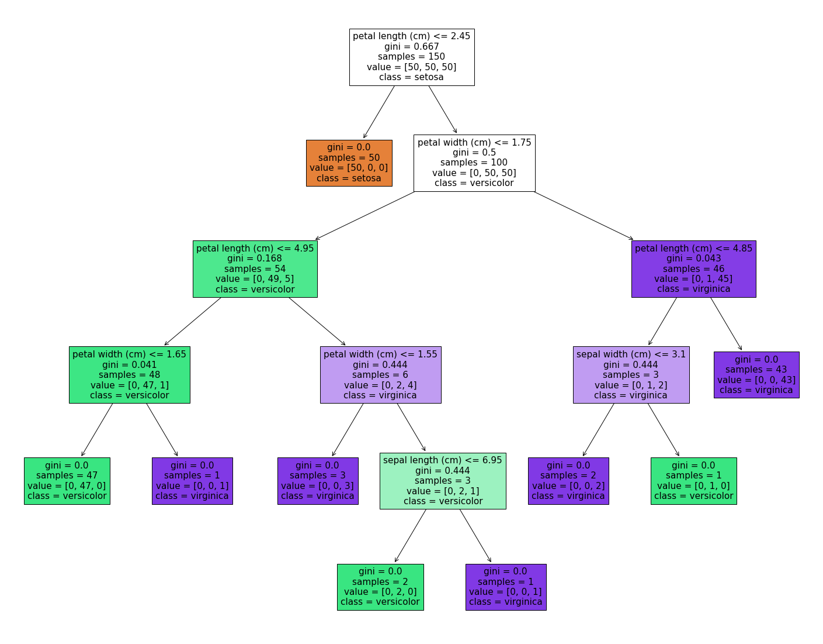
Modeling: Decision Tree
Data Collection
Data Preparation
Data Exploration
Understanding the ML Workflow
Feature Engineering
Modeling
Validation
Interpretation
Deployment

Slide 40
Demo: Decision Tree
A visual explanation of decision tree

Slide 41
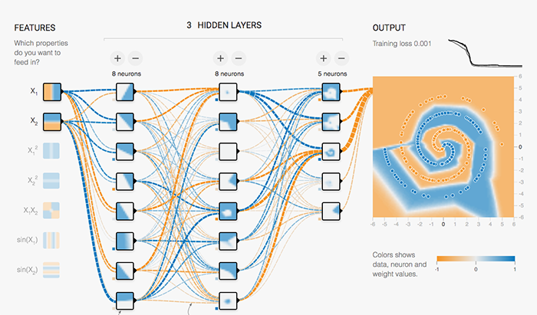
Modeling: Neural Networks
Data Collection
Data Preparation
Data Exploration
Understanding the ML Workflow
Feature Engineering
Modeling
Validation
Interpretation
Deployment

Slide 42
Demo: Neural Networks
Neural network playground

Slide 43
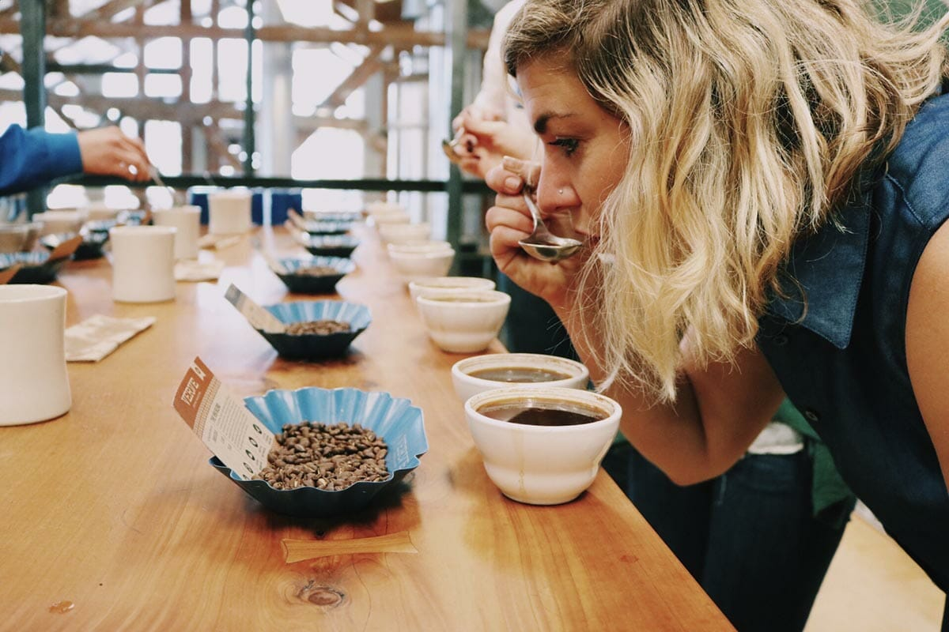
Evaluation & Validation
Data Collection
Data Preparation
Data Exploration
Understanding the ML Workflow
Feature Engineering
Modeling
Validation
Interpretation
Deployment
Plant
Harvest
Process
Grading
How do we know that the model works?
Latte
Brew
Grind
Roast
Model Evaluation
We need a set of metrics to benchmark the model performance
Model Validation
We also want to know that the model is well tested and the good result is reproducible.

Slide 44
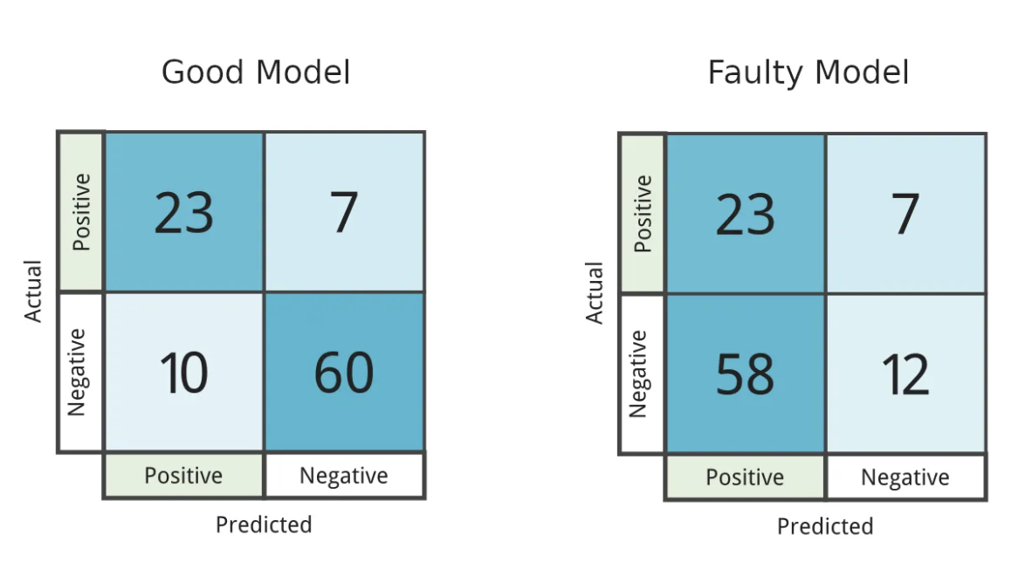
Model Evaluation
Data Collection
Data Preparation
Data Exploration
Understanding the ML Workflow
Feature Engineering
Modeling
Validation
Interpretation
Confusion Matrix
Deployment

Slide 45
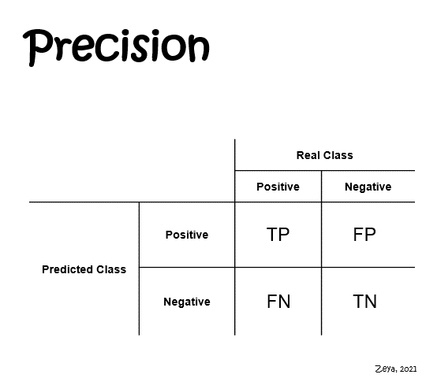
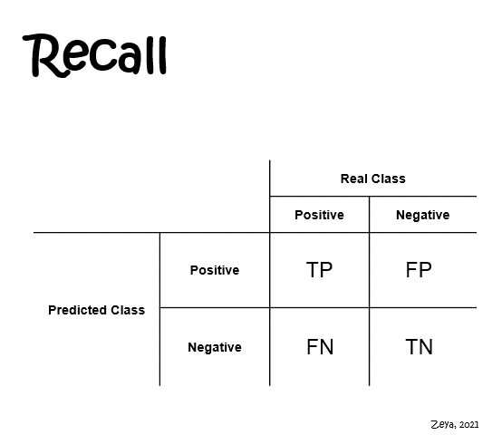
Model Evaluation
Data Collection
Data Preparation
Data Exploration
Understanding the ML Workflow
Feature Engineering
Modeling
Validation
Interpretation
Precision & Recall
Deployment
Source: Precision and recall made simple (link)
Notes:
Imagine you're a skilled fisher casting a net into a small lake to catch fish. You specifically want bass fish but the lake has many types of fish.
Precision is like the % of the fish you catch that are bass —how accurate your technique is for bass.
On the other hand, recall is like the % of the all the bass in the lake that you manage to catch—how effectively your technique retrieves bass. So, in the world of machine learning, precision is about how many bass you catch vs. other fish, while recall is about how much bass you don't let slip away.
The fisher would need to find a balance between precision and recall based on their specific goals and constraints. If the fisher is aiming for a high-quality catch and is concerned about accidentally catching the wrong type of fish, they would optimize for precision. On the other hand, if the fisher's primary concern is to not miss any of the target fish, even if it means catching some undesired ones, they would optimize for recall. The optimal balance depends on the priorities and trade-offs that align with the fisher's fishing objectives. In a similar way, in machine learning, the choice between precision and recall optimization depends on the specific requirements of the task at hand.

Slide 46
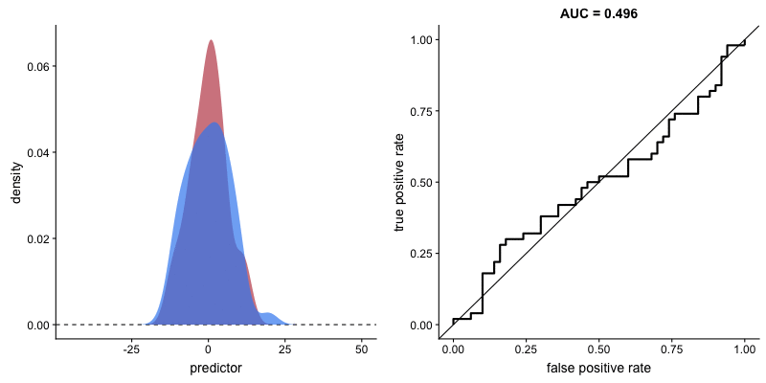
Model Evaluation
Data Collection
Data Preparation
Data Exploration
Understanding the ML Workflow
Feature Engineering
Modeling
Validation
Interpretation
Deployment
ROC
Source: ROC, AUC, precision, and recall visually explained (link)
Notes:
ROC stands for Receiver Operating Characteristic, and it is a graphical representation used to evaluate the performance of classification models. Specifically, it illustrates the tradeoff between the true positive rate (sensitivity or recall) and the false positive rate across different threshold settings.
The ROC curve visually depicts how the model's performance varies with different threshold values for classifying positive and negative instances. A steeper curve indicates better performance, and the area under the ROC curve (AUC-ROC) summarizes the model's overall discriminatory power. A higher AUC-ROC suggests better separation between positive and negative instances, making it a widely used metric for comparing and selecting models in binary classification tasks.

Slide 47
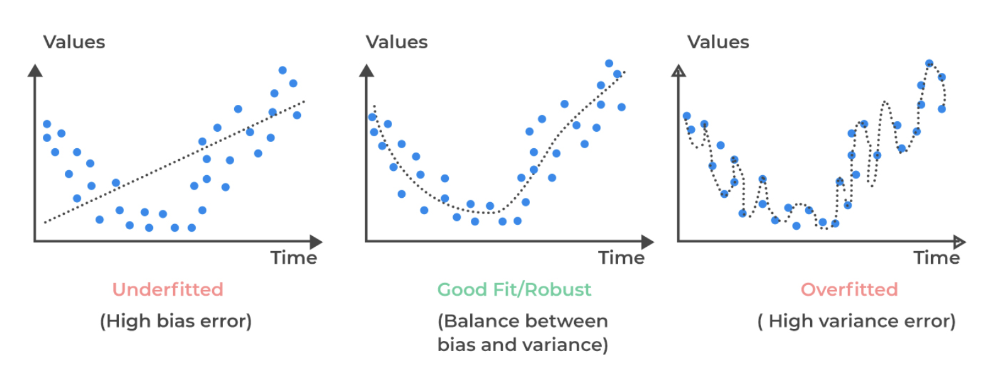
Model Validation
Data Collection
Data Preparation
Data Exploration
Understanding the ML Workflow
Feature Engineering
Modeling
Validation
Interpretation
Generalization & Fit
Deployment
Source: Overfitting and methods of addressing it (link)

Slide 48
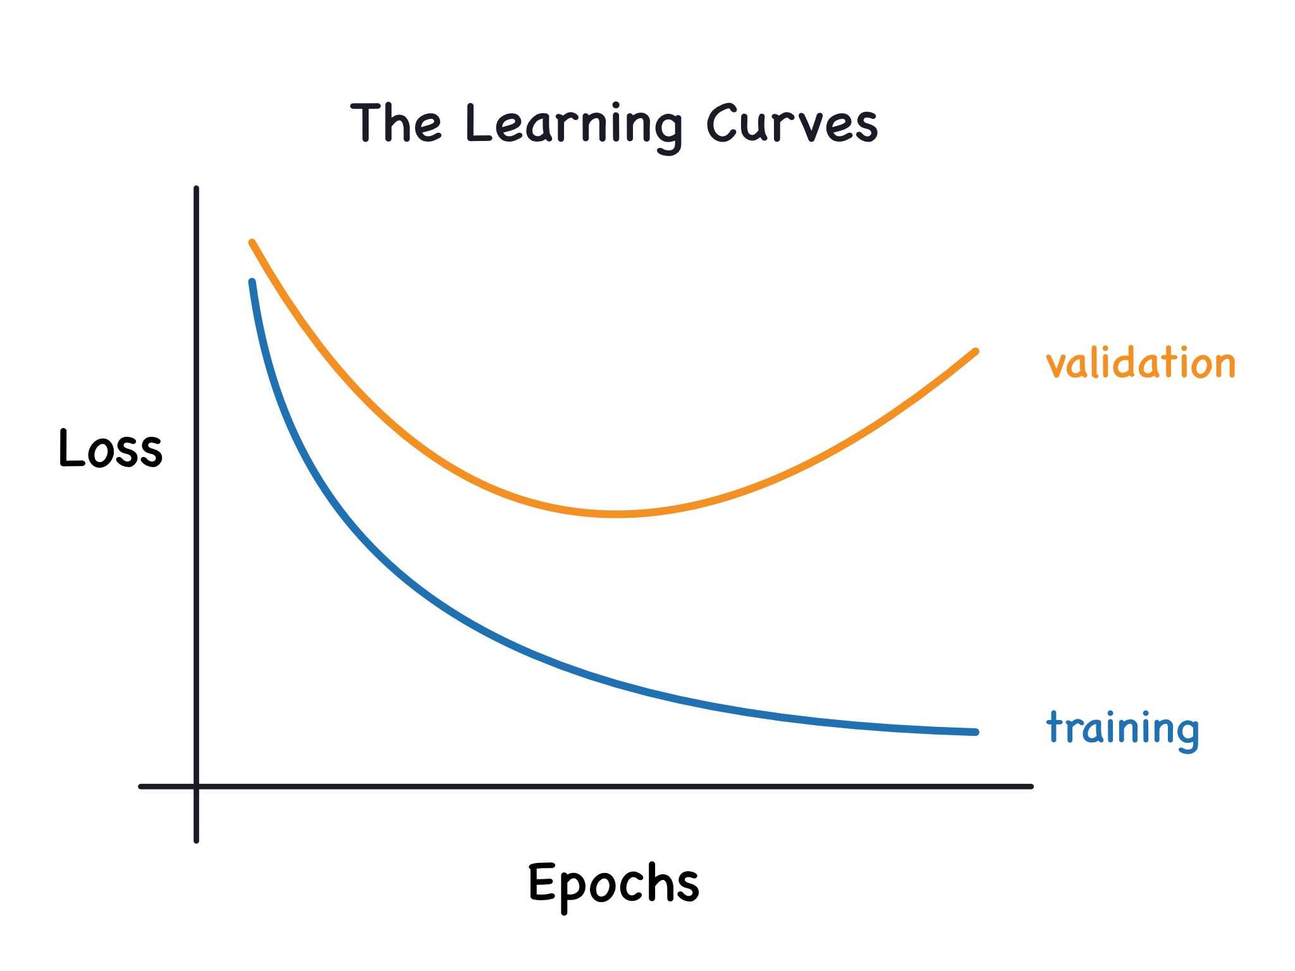
Model Validation
Data Collection
Data Preparation
Data Exploration
Feature Engineering
Understanding the ML Workflow
Modeling
Validation
Interpretation
Learning Curves
Deployment

Slide 49
Model Validation
Data Collection
Data Preparation
Data Exploration
Feature Engineering
Understanding the ML Workflow
Modeling
Validation
Interpretation
Data Splitting
Deployment
Classification
Model
Train
Train
Test
Test
Prediction

Slide 50
Demo: Evaluation & Validation
https://mlu-explain.github.io/train-test-validation

Slide 51

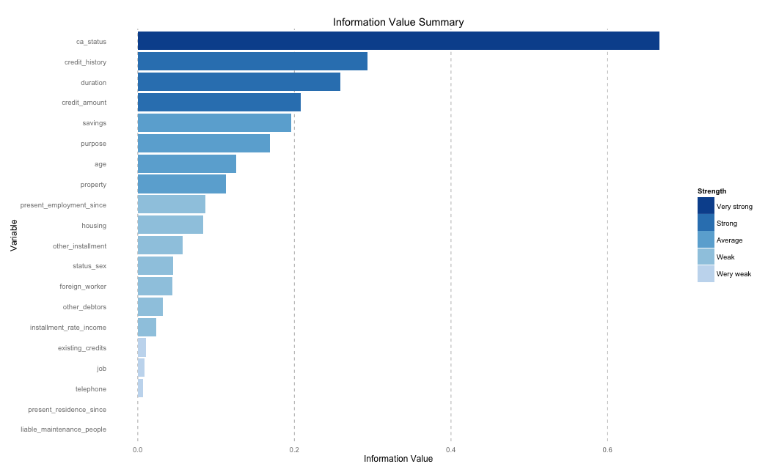
Interpretation
Data Collection
Data Preparation
Data Exploration
Understanding the ML Workflow
Feature Engineering
Modeling
Validation
Interpretation
Deployment
Plant
Harvest
Process
Grading
How do we use the model? What features influence the model prediction?
Latte
Brew
Grind
Roast

Slide 52
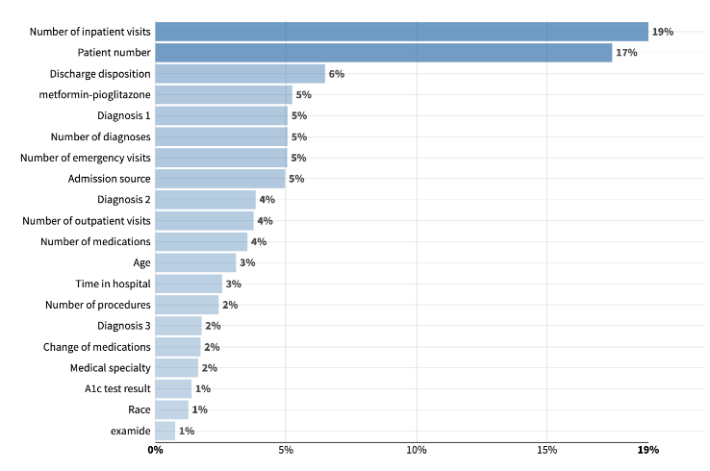
Interpretation - Feature Importance
Data Collection
Data Preparation
Data Exploration
Understanding the ML Workflow
Feature Engineering
Modeling
Validation
Interpretation
Deployment

Slide 53
Deployment
Data Collection
Data Preparation
Data Exploration
Understanding the ML Workflow
Feature Engineering
Modeling
Validation
Interpretation
Plant
Harvest
Process
Grading
Deployment
Latte
Brew
Grind
Roast

